Slide 1
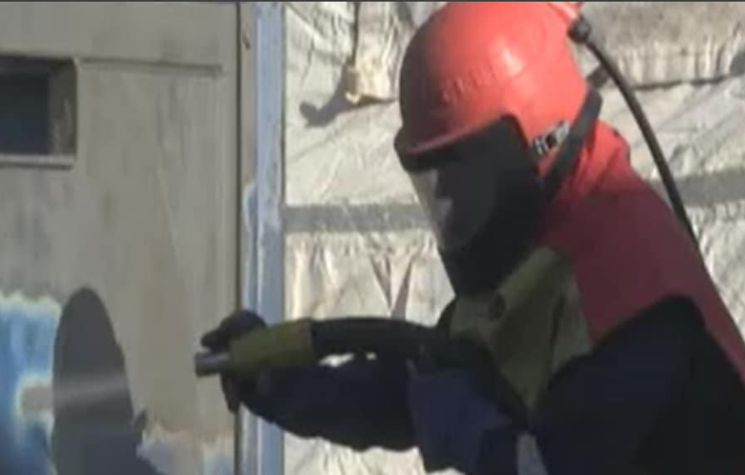




GROUP
VAPOR BLAST
Vapor Blast
Next generation in surface preparation

Slide 2
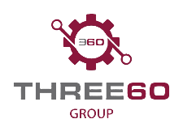
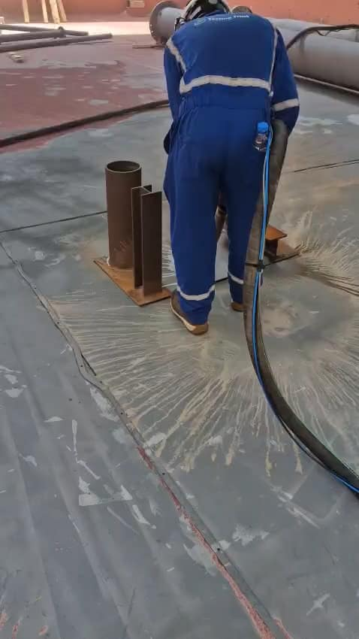





Discover the efficiency of vapor blasting, adeptly combining degreasing, Salt removal, and blasting for diverse industrial parts. This advanced technique utilizes water-borne abrasives for a finer, cleaner finish, without embedding media into components. Unlike traditional dry blasting, vapor blasting is completely dust-free, making it ideal for maintaining a pristine workshop environment. Embrace the dual power of precision and cleanliness with vapor blasting.
HOVER OVER THE IMAGE TO START VIDEO
Reduced Dust Generation: Drastically cuts out the dust, increasing productivity, boosting safety and comfort, especially in confined areas.
Environmental: Reduces grit consumption by up to 60% also reducing the use of plastics for habitats by 90%.
No excessive fresh-water use
Uniform Cleaning & Finishing: Vapor Blast can achieve SA-2.5 SA-3 Visual standard. Zero surface contamination left after blast
Manpower:
Reduces impact on SIMOPS, also removing the need for additional Scaffold manpower for habitats

Slide 3
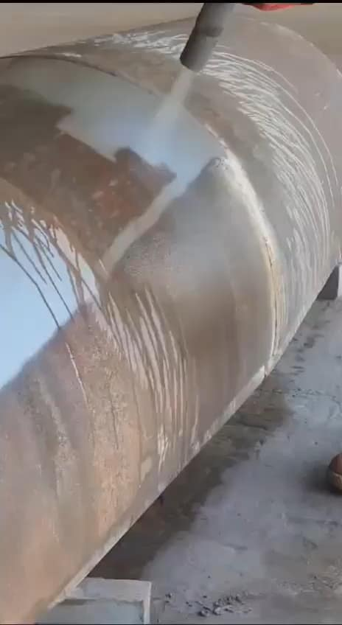
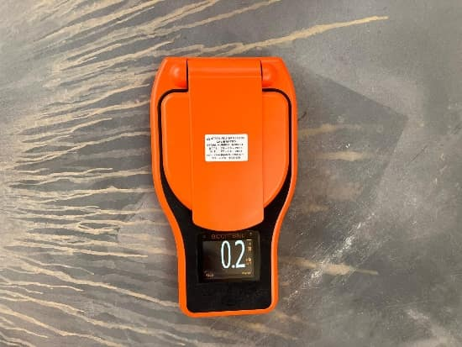
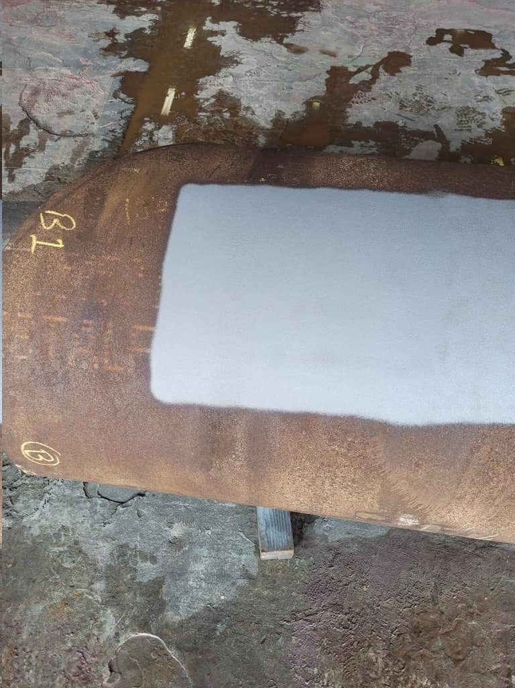
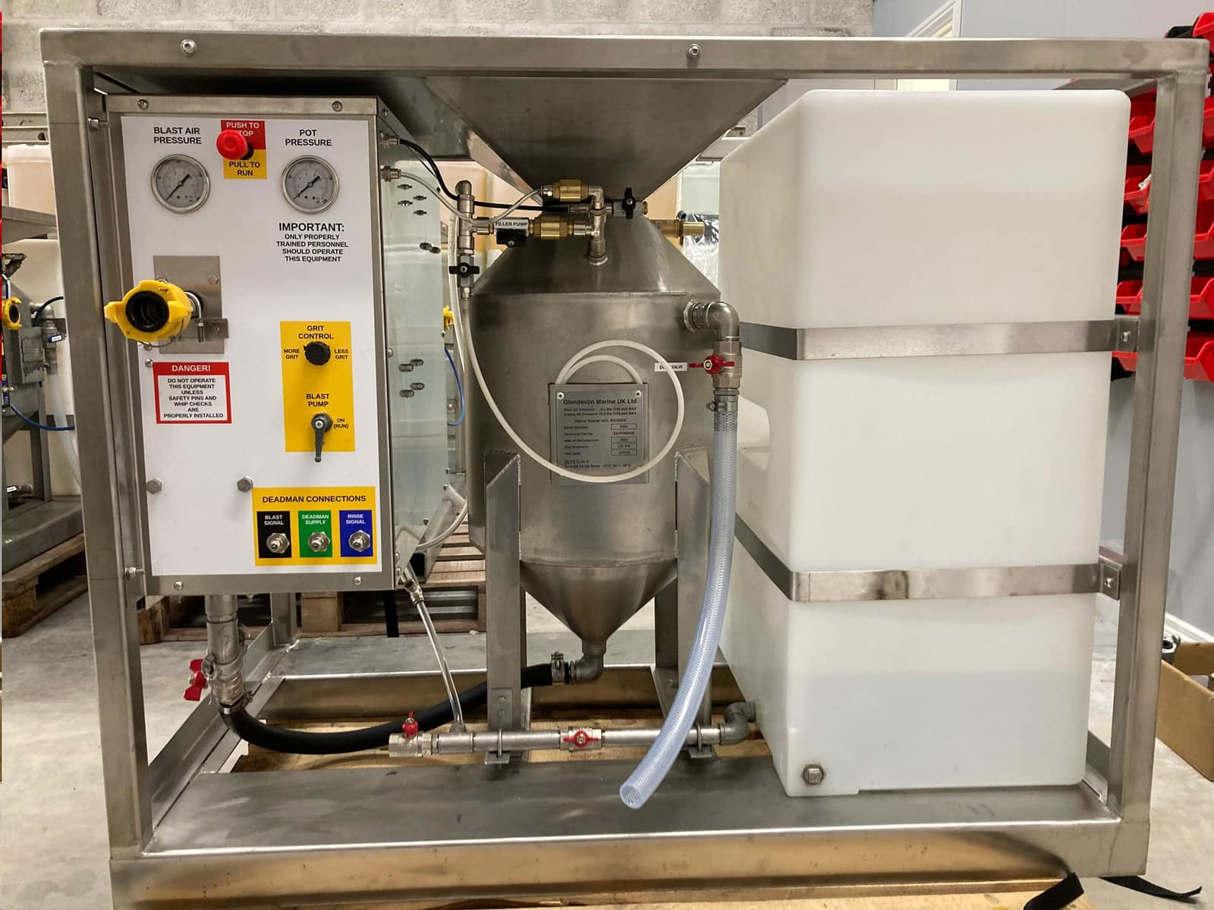
Another live blasting video close up
No dust
No water puddles
Great productivity
Very clean profile
HOVER OVER IMAGE TO START VIDEO
Salt reading on Elcometer 130 is almost zero, unmatched by alternative methods
SA3 Cleanliness achieved
Vapor Unit no bigger than a pallet and ATEX zone 1 rated

Slide 4

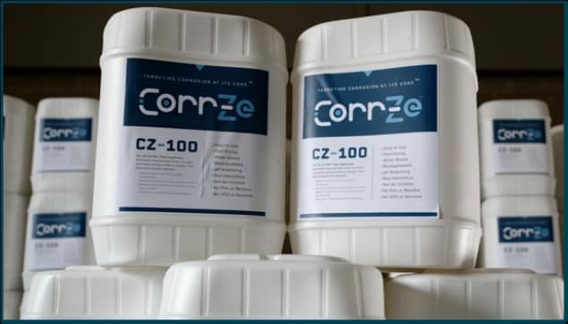


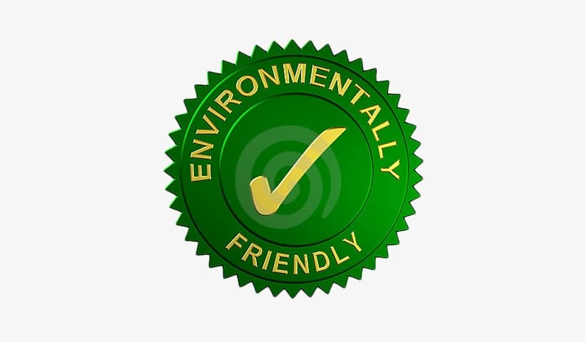
Enhancing with Corrze ™
Corr-Ze™ metal surface preparation products are guaranteed to improve coating adhesion and prevent under-film corrosion.
Corr-Ze™ 100 is a “single step” Non hazardous water additive that is incorporated into the blast stream of Ultra High-Pressure Water (“UHP”), Wet Abrasive.
Provides higher bond strength, which extends coating life without leaving a film on the substrate, Improving Adhesion by 40%
Corr-Ze™ 100 cleans the substrate, leaving it free of contaminants, preventing flash rust for extended periods.
Approved for use with leading coating manufacturers
Jotun
Hempel
Carboline
PPG

Slide 5
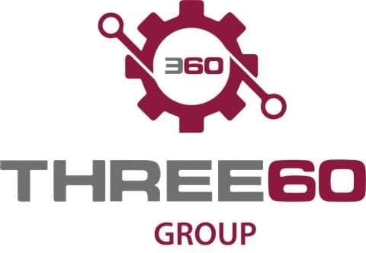
Three Sixty Industrial Services and Trading - Corr-Ze System Introduction
August 2025

Slide 6
Company and Industry Overview
Three Sixty Industrial Services and Trading is introducing disruptive technology to address problems that have plagued the surface preparation industry for decades
Three Sixty Industrial Services and Trading: We are a distributor of the Corr-Ze™ product line in the Middle East, an innovative Coating Edge Technology™. Corr-Ze™ is a superior surface treatment and unique cleaning process that prepares substrates for protective coating applications. Corr-Ze™ removes the non-visible cause of coating failures and prevents corrosion even in the most corrosive environments.
Our Team: Our team consists of over 150 years in coating chemistry and application experience
Our Promise: Our products will reduce rework, eliminate time constraints, allow for greater control and flexibility in project management, greatly reduce downtime and provide superior surface preparation
The manner in which corrosion has been managed and mitigated has not changed in 75 years, with the same issues causing premature coating system failures, significant rework, and substantial project downtime:
Contaminated Substrate | Flash Rust | Weather | Rework
Traditional blasting methods leave behind harmful contaminants on the substrate | Traditional surface preparation systems require coating application immediately following blasting to prevent flash rusting | Inclement weather shuts down blasting operations resulting in any exposed steel to be re-blasted | These issues cause significant project delays and increased costs
1

Slide 7
Corr-Ze™ 100
Product Overview
Easy To Use | Corr-Ze™ 100 is a “single step” water additive that is incorporated into the blast stream of Ultra High-Pressure Water (“UHP”), Wet Abrasive, or applied after using conventional dry abrasive systems.
Improves Quality | Provides higher bond strength, which extends coating life without leaving a film on the substrate.
Limit Weather Impact | Corr-Ze™ 100 cleans the substrate, leaving it free of contaminants, preventing flash rust for extended periods depending on environmental conditions.
Environmental Stewardship | Non-toxic, environmentally friendly and approved for direct runoff by the EPA & DEQ into the waters off the coast of California and the Gulf of Mexico. Eliminating rework reduces equipment run time (UHP, Air compressors) supply boat runs, aggregate consumption, and paint material waste positively impacts carbon emissions.
2

Slide 8



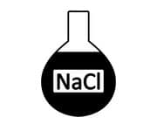

Corr-Ze™ – Executive Summary
Our Corr-Ze easy-to-use products are biodegradable, non-toxic, non-flammable, water-based, and fast-drying. Our products are not inhibitors or film formers and will improve adhesion of any coating system.
Clean substrates are vital for protective coatings, fireproofing, thermal spray, immersion, and submersion applications. Let the experts at Three Sixty Group help.
5

Slide 9
Technical

Slide 10

Research and Evaluation
Removal of all Non-Visible Contaminants
Carbon Steel Plate Blasted to NACE No.1 / SSPC 5 viewed under a microscope after 4 hours. Residual sulfides, chlorides and flash oxidation remain.
Carbon Steel Plate Blasted to NACE No.1 / SSPC 5 viewed under a microscope after 4 hours treated with Corr-Ze. A visible, clean angular profile with no contaminants.

Slide 11
Research and Evaluation
Adhesion Testing
Adhesion tests have been conducted by 4 major oil companies and 4 coating companies.
Results showed excellent pull strength on surfaces, ranging from 1000-3200 psi. Breaks were cohesion only.
A recent pull test performed on a platform treated with Corr-Ze™ in the Gulf of Mexico showed 1200 and 1600 psi 5 years later.
Results showed lower pre-coat surface conductivity and higher post-aging tensile strength adhesion.
Corr-Ze™ surface preparation was determined to be compatible with all coatings tested.

Slide 12
Research and Evaluation
The Corr-Ze™ Technology has been reviewed and recognized by peers across the industry
The Corr-Ze™ Technology was evaluated by two of the leading Coating Researchers in the world.
The researchers are two of the most published and recognized with International Paint Company.
Results of their evaluations of Corr-Ze™ were very positive and the results were published by NACE in a White Paper, released February 2016.
This research is also the feature article, entitled “Russian Roulette: Coating Performance and Sulfide Removal Treatment” the November 2016 issue of the Journal of Protective Coatings and Linings (JPCL).
This article, along with the below articles, reports and data sheets referencing The Corr-Ze™ Technology, are available upon request:
NACE Paper No. 13218 - Impact of Very Low Concentration of Soluble Salts on Coatings Performance
Environmental Enterprises USA – Corr-Ze 200 & Corr-Ze 100 Biomonitoring Report
Rabbit Skin Corrosion (DOT) report
Product Safety Data Sheets

Slide 13
GROUP
CONTACT DETAILS
Phone: +974 77888162
Website: www.three60group.com
Email Address: bob.jack@three60group.com

